Slide 1
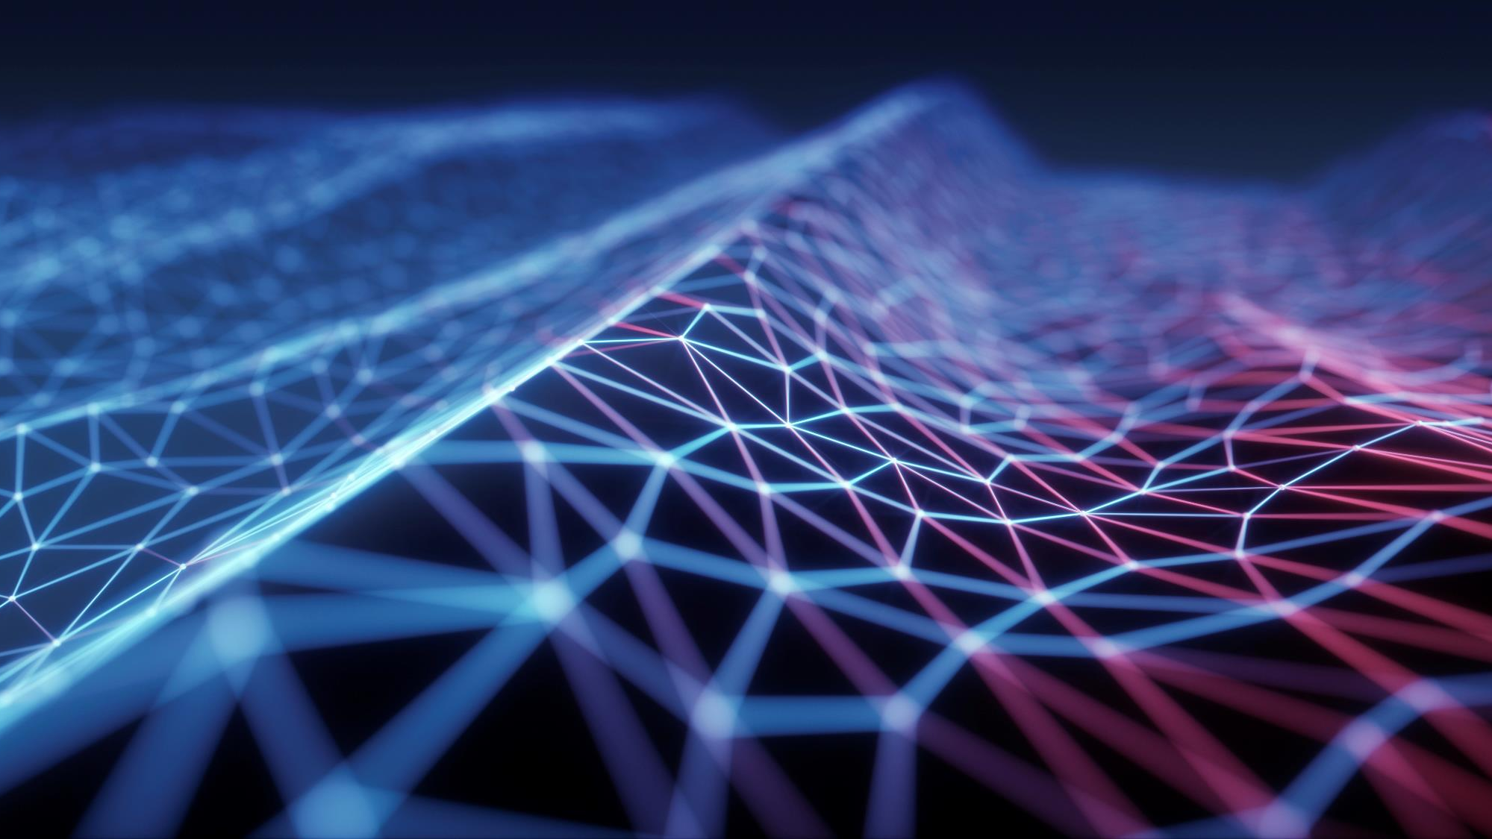
Artificial Neural Networks
Presentation 1

Slide 2
OUTLINE
Introduction
History
Architecture
Applications
Practical example

Slide 3
Introduction
The term ‘Neural’ has origin from the human (animal) nervous system’s basic functional unit called ‘neuron’ or nerve cells, present in the brain and other parts of the human (animal) body.
Artificial neural networks (ANNs), usually simply called neural networks (NNs), are computing systems inspired by the biological neural networks.
Most simplest neural network with only one hidden layer is called “perceptron”.

Slide 4
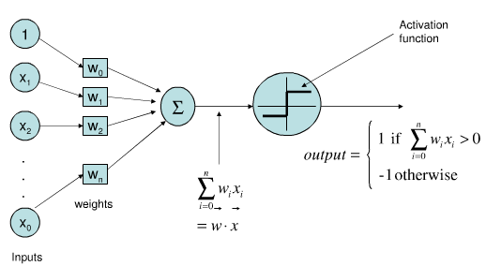
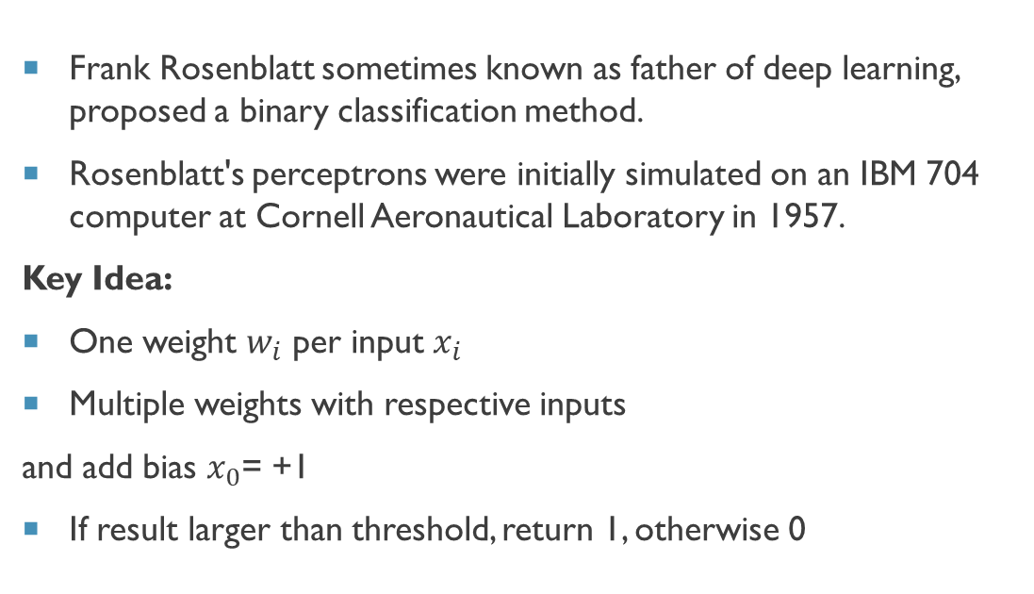
Perceptron (Single layer NN)
Frank Rosenblatt sometimes known as father of deep learning, proposed a binary classification method.
Rosenblatt's perceptrons were initially simulated on an IBM 704 computer at Cornell Aeronautical Laboratory in 1957.
Key Idea:
One weight $w_{i}$ per input $x_{i}$
Multiple weights with respective inputs
and add bias $x_{0}$= +1
If result larger than threshold, return 1, otherwise 0

Slide 5
Multi layer Neural network

Slide 6
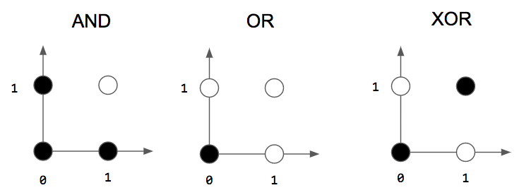
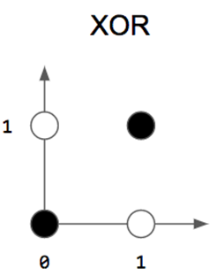
Why increase hidden layers?
Linearly Separable Problem
Nonlinearly Separable Problem
Perceptron # 2
Perceptron # 1

Slide 7
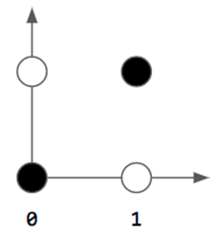









Multilayer Neural network
Perceptron # 1
Right approach
$$w_{11}$$
$$x_{1}$$
∑
$$w_{11}$$
$$w_{12}$$
$$\hat{y}$$
$$w_{21}$$
∑
$$x_{2}$$
$$w_{22}$$
∑
$$w_{21}$$
Perceptron # 3
Perceptron # 2
Wrong approach

Slide 8
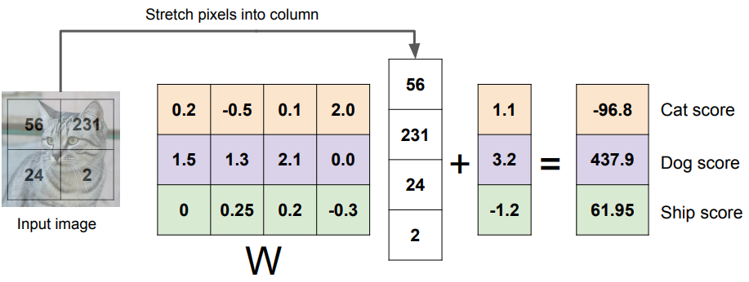
Image Classification (example)
Bias vector
Class scores
Weights/ parameters matrix

Slide 9
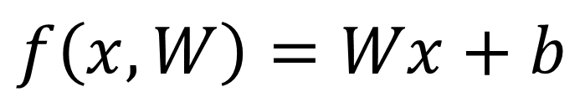
Image Classification (example)
$$f\left(x,W\right)=Wx+b$$

Slide 10
Image Classification (example)
< 0<
Not Cat

Slide 11
Image Classification (example)
< 0
Not Cat
What to do?

Slide 12
Image Classification (example)
< 0
Not Cat
Where I did wrong?

Slide 13
Image Classification (example)
< 0
Not Cat
Where I did wrong?

Slide 14
Image Classification (example)
< 0
Not Cat
Ok, how to fix?

Slide 15
Image Classification (example)
< 0
Not Cat
Ok, how to fix?
Ans: Learning Algo.

Slide 16
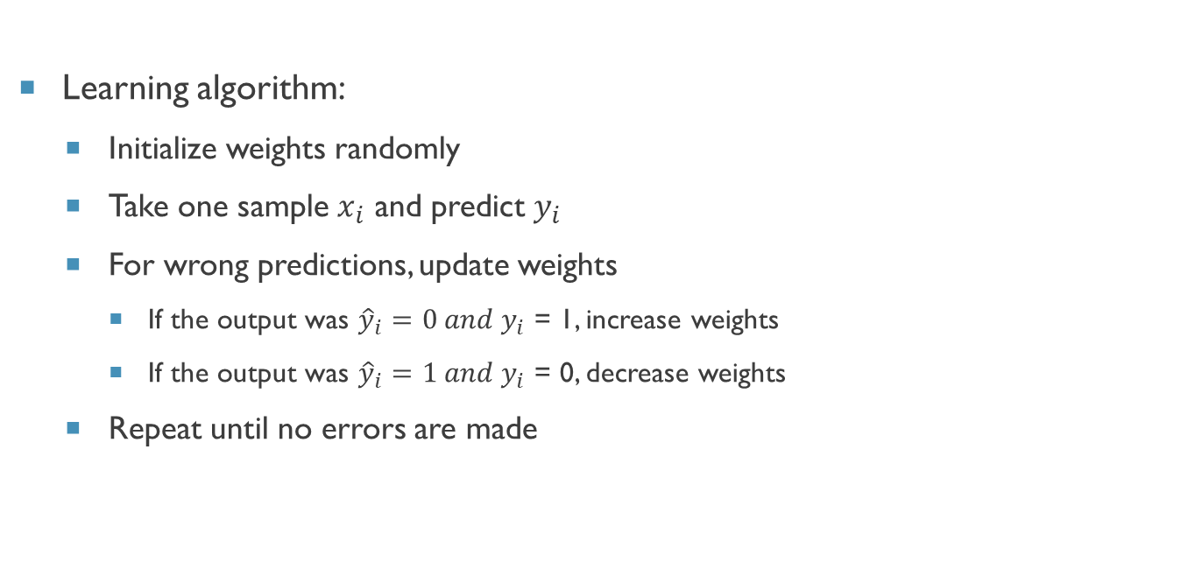
Training
Learning algorithm:
Initialize weights randomly
Take one sample $x_{i}$ and predict $y_{i}$
For wrong predictions, update weights
If the output was ${\hat{y}}_{i}=0 and y_{i}$ = 1, increase weights
If the output was ${\hat{y}}_{i}=1 and y_{i}$ = 0, decrease weights
Repeat until no errors are made

Slide 17
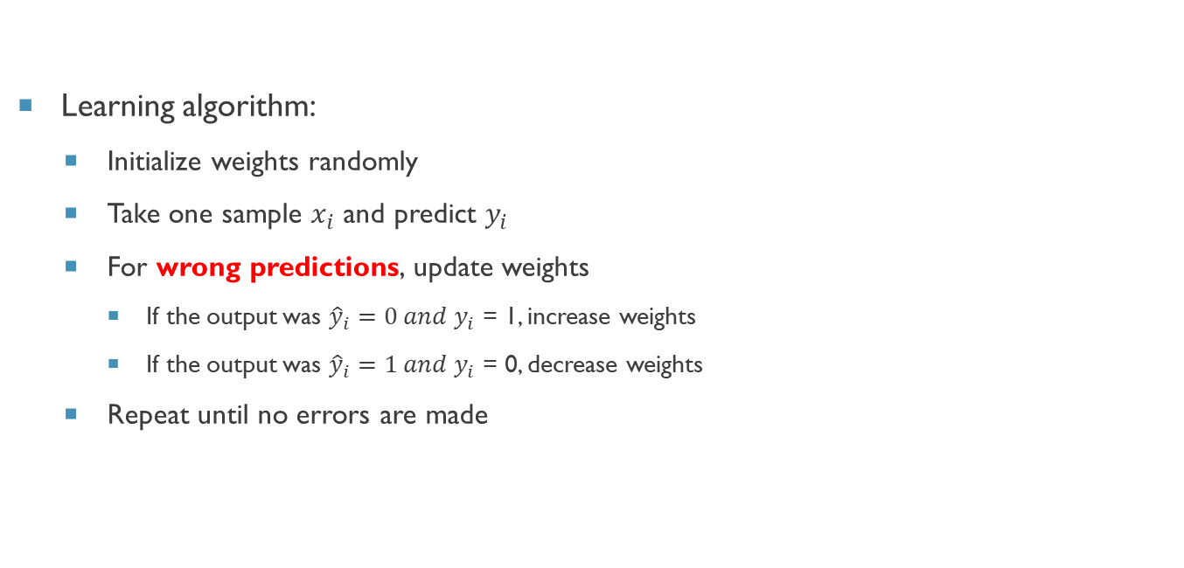
Training
Learning algorithm:
Initialize weights randomly
Take one sample $x_{i}$ and predict $y_{i}$
For wrong predictions, update weights
If the output was ${\hat{y}}_{i}=0 and y_{i}$ = 1, increase weights
If the output was ${\hat{y}}_{i}=1 and y_{i}$ = 0, decrease weights
Repeat until no errors are made
But, how do the algorithm knew that the predictions are wrong?

Slide 18
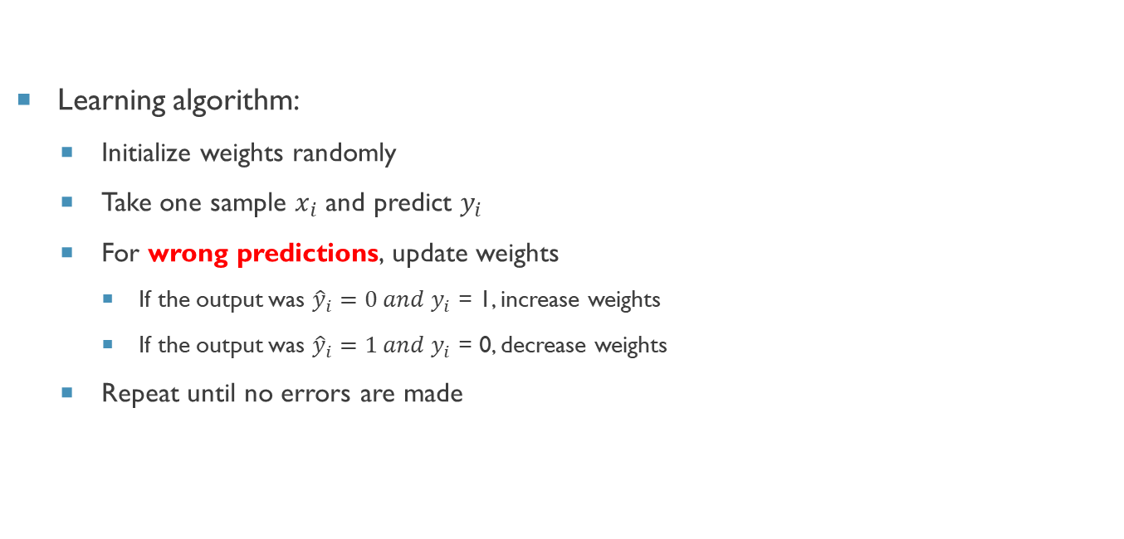
Training
Learning algorithm:
Initialize weights randomly
Take one sample $x_{i}$ and predict $y_{i}$
For wrong predictions, update weights
If the output was ${\hat{y}}_{i}=0 and y_{i}$ = 1, increase weights
If the output was ${\hat{y}}_{i}=1 and y_{i}$ = 0, decrease weights
Repeat until no errors are made
But, how do the algorithm knew that the predictions are wrong?
Cost function/ loss function tell it.

Slide 19
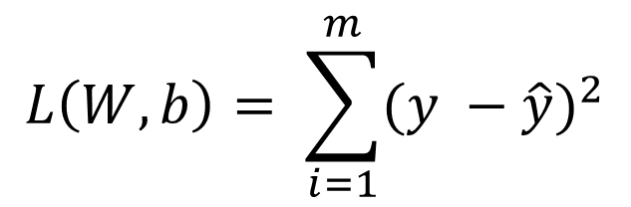
Training
Learning algorithm:
Initialize weights randomly
Take one sample $x_{i}$ and predict $y_{i}$
For wrong predictions, update weights
If the output was ${\hat{y}}_{i}=0 and y_{i}$ = 1, increase weights
If the output was ${\hat{y}}_{i}=1 and y_{i}$ = 0, decrease weights
Repeat until no errors are made
What is Cost function?
Actual class
Predicted class
$$L\left(W,b\right)= \sum_{i=1}^{m}{{(y −\hat{y})}^{2}}$$

Slide 20
History
Warren McCulloch and Walter Pitts (1943) opened the subject by creating a computational model for neural networks.
In 1958, psychologist Frank Rosenblatt invented the perceptron, the first artificial neural network, funded by the United States Office of Naval Research. [1]
The first functional networks with many layers were published by Ivakhnenko and Lapa in 1965, as the Group Method of Data Handling.
The basics of continuous backpropagation were derived in the context of control theory by Kelley in 1960 and by Bryson in 1961, using principles of dynamic programming.
Minsky & Papert (1969) offered solution to XOR problem by combining perceptron unit responses using a second layer of Units. [2]
Notes:
[1] Rosenblatt, F. (1958). The perceptron: A probabilistic model for information storage and organization in the brain. Psychological Review, 65(6), 386–408. https://doi.org/10.1037/h0042519
[2] Perceptrons: An Introduction to Computational Geometry, Expanded Edition Expanded, Subsequent Edition
by Marvin Minsky (Author), Seymour A. Papert (Author)

Slide 21
History
Werbos's (1975) backpropagation algorithm enabled practical training of multi-layer networks. [3]
In 1982, he applied Linnainmaa's AD method to neural networks in the way that became widely used.
Backpropagation distributed the error term back up through the layers, by modifying the weights at each node.
Since then many new architectures are proposed and used.
This advancement is not going to stop anytime soon.
Notes:
[3] Werbos, P.J. (1990). Backpropagation Through Time: What It Does and How to Do It.

Slide 22
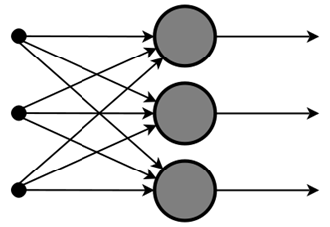
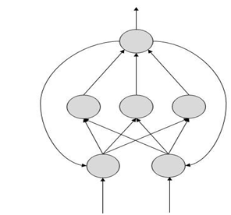
Architecture
There are two Artificial Neural Network topologies − Feed Forward and Feedback.
Feed Forward ANN
In this ANN, the information flow is unidirectional.
A unit sends information to another unit from which it does not receive any information.
There are no feedback loops.
They are used in pattern generation/recognition/classification.
They have fixed inputs and outputs.
Feed Back ANN
Here, feedback loops are allowed.
They are used in content-addressable memories.

Slide 23
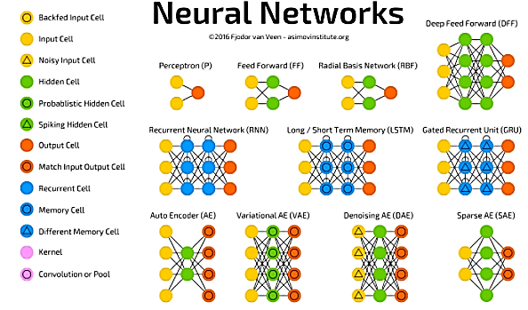
Architecture
Some basic
Architectures:

Slide 24
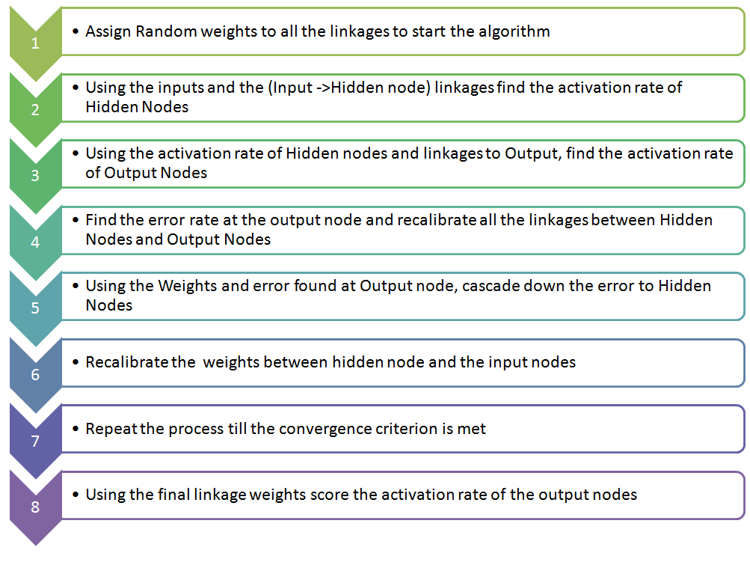
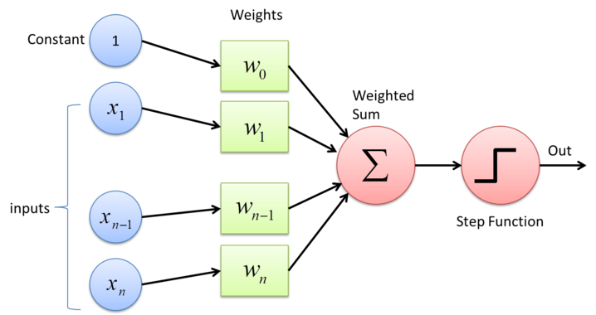
architecture
Complete Algorithm for ANN architecture and key components.

Slide 25
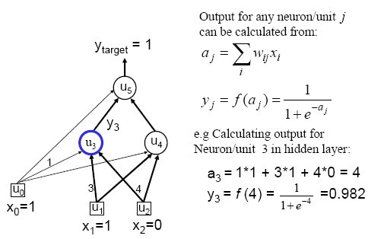
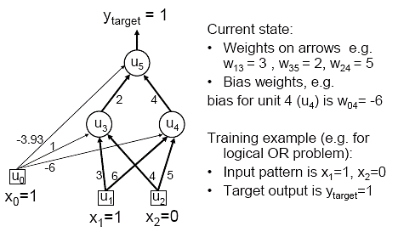
Or example - Forward Pass
Step 1
Step 2

Slide 26
Back-propagation of error
Calculate error:
Compute delta values for output unit:
Compute delta for hidden units:
Weight change
Update weights

Slide 27
Architecture
Forward pass
Backward pass

Slide 28
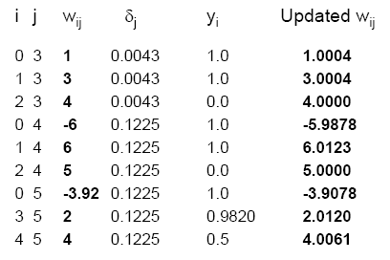
Update Weights Using Generalized Delta Rule (BP)

Slide 29
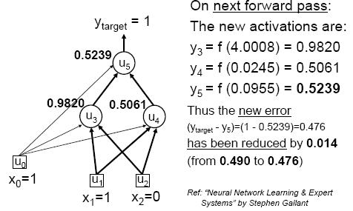
Verification- Final step

Slide 30
Applications
Character Recognition – The idea of character recognition has become very important as handheld devices like the Palm Pilot are becoming increasingly popular. Neural networks can be used to recognize handwritten characters.
Image Compression - Neural networks can receive and process vast amounts of information at once, making them useful in image compression. With the Internet explosion and more sites using more images on their sites, using neural networks for image compression is worth a look.
Stock Market Prediction - The day-to-day business of the stock market is extremely complicated. Many factors weigh in whether a given stock will go up or down on any given day. Since neural networks can examine a lot of information quickly and sort it all out, they can be used to predict stock prices.

Slide 31
Applications
Medicine, Electronic Nose, Security, and Loan Applications - These are some applications that are in their proof-of-concept stage, with the acceptation of a neural network that will decide whether or not to grant a loan, something that has already been used more successfully than many humans.
Miscellaneous Applications - These are some very interesting (at times a little absurd) applications of neural networks.

Slide 32
Limitations
Like every other method of analysing Big Data, a neural network is not without its limitations.
Although a neural network can often work effectively with vague and incomplete information, the outcome can be incomplete as well.
Not every data set is suitable for a neural network either.

Slide 33
Advantages of ANN
Storing information on the entire network.
Ability to work with incomplete knowledge .
Having fault tolerance: Corruption of one or more cells of ANN does not prevent it from generating output.
Gradual corruption: A network slows over time and undergoes relative degradation. The network problem does not immediately corrode immediately.
Ability to make machine learning: Once trained, the predictions are pretty fast.
Parallel processing capability: Artificial neural networks have numerical strength that can perform more than one job at the same time.

Slide 34
Disadvantages of ANN
Neural networks are black boxes, meaning we cannot know how much each independent variable is influencing the dependent variables.
It is computationally very expensive and time consuming to train with traditional CPUs.
Neural networks depend a lot on training data. This leads to the problem of over-fitting and generalization. The model relies more on the training data and may be tuned to the data.
Unexplained behaviour of the network: This is the most important problem of ANN. When ANN produces a probing solution, it does not give a clue as to why and how. This reduces trust in the network.

Slide 35
Practical Example
I am going to use the Pima Indians onset of diabetes dataset which is a standard machine learning dataset from the UCI Machine Learning repository.
This dataset tells about the patient medical record and whether they had an onset of diabetes within five years also it is a binary classification problem.
This dataset consists of several medical predictor (independent) variables and one target (dependent) variable, Outcome. Independent variables include the number of pregnancies the patient has had, their BMI, insulin level, age, and so on.
The first eight columns represent the independent variables, and the last column denotes the binary dependent variable. There are a total of 768 entries in the dataset. The outcome variable is set to 1 for 268 entries, and the rest are set to 0.

